Slide 1
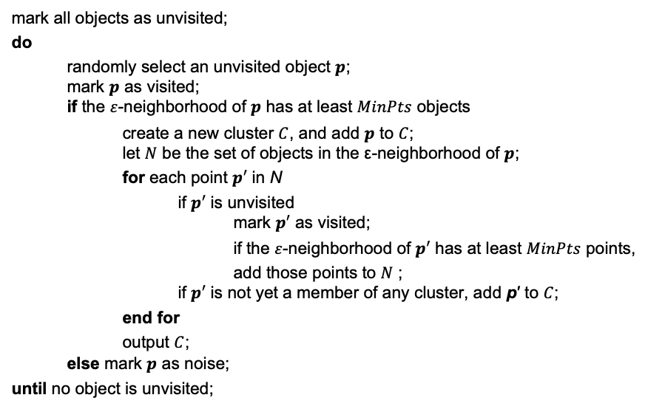
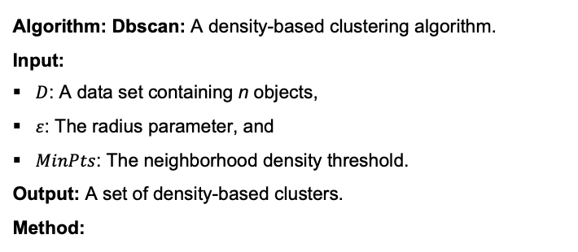
Algorithm: Dbscan: A density-based clustering algorithm.
Input:
$D$: A data set containing n objects,
$ε$: The radius parameter, and
$MinPts$: The neighborhood density threshold.
Output: A set of density-based clusters.
Method:
(1)
(2)
(3)
(4)
(5)
(6)
(7)
(8)
(9)
(10)
(11)
(12)
(13)
(14)
(15)
(16)
mark all objects as unvisited;
do
randomly select an unvisited object $p$; mark $p$ as visited; if the $ε$-neighborhood of $p$ has at least $MinPts$ objects
create a new cluster $C$, and add $p$ to $C$; let $N$ be the set of objects in the ε-neighborhood of $p$;
for each point $p′$ in N
if $p′$ is unvisited mark $p′$ as visited;
if the $ε$-neighborhood of $p′$ has at least $MinPts$ points,
add those points to $N$ ; if $p′$ is not yet a member of any cluster, add p′ to $C$;
end for
output $C$; else mark $p$ as noise;
until no object is unvisited;

